Slide 1

“Mind Spectrum: Nurturing Mental
Well-being Across Ages"
V.L.VISHWA SELVAM
VEL TECH HIGH TECH Dr. RANGARAJAN Dr. SAKUNTHALA ENGINEERING COLLEGE
An Autonomous Institution

Slide 2
INTRODUCTION:
In an era where the digital landscape significantly influences the lives of adolescents, there's an ever-growing need for innovative solutions that cater to their mental well-being.
Teenagers today face a myriad of emotional challenges, from the pressures of social media to the stresses of academic life, leading to an increase in mental health concerns.
Recognizing the pivotal role technology plays in their lives, the development of a web application that aids in the mental stability of adolescents by utilizing text and voice input presents a novel approach to addressing these challenges.

Slide 3
PROBLEM & THEORIES:
Objective:
Determine what specific aspects of mental fitness and stability the chatbot will address
(e.g., stress management, anxiety reduction, mood tracking).
Target Audience:
Identify the demographic the chatbot will serve. This could be broad or niche
(e.g., no age limit, specific stressors).
Ethical Considerations and Privacy Confidentiality:
Ensure the chatbot upholds strict privacy standards to protect user data.
Limitations:
Clearly communicate the chatbot’s limitations and provide resources for users who may need professional help.
Consent:
Obtain user consent for data collection and explain how their data will be used.

Slide 4
The web app, aimed at fostering a supportive environment for emotional growth and stability, leverages the familiarity and accessibility of digital technology to reach teenagers in a medium they are comfortable with.
The approach not only facilitates immediate emotional relief but also contributes to long-term mental resilience.
As we embark on the journey of developing this web application, our goal is clear: to create a digital haven where can navigate their emotional challenges with confidence and support.
By harnessing the power of technology, we aim to empower the younger generation to achieve mental stability and thrive in the face of adversity.

Slide 5
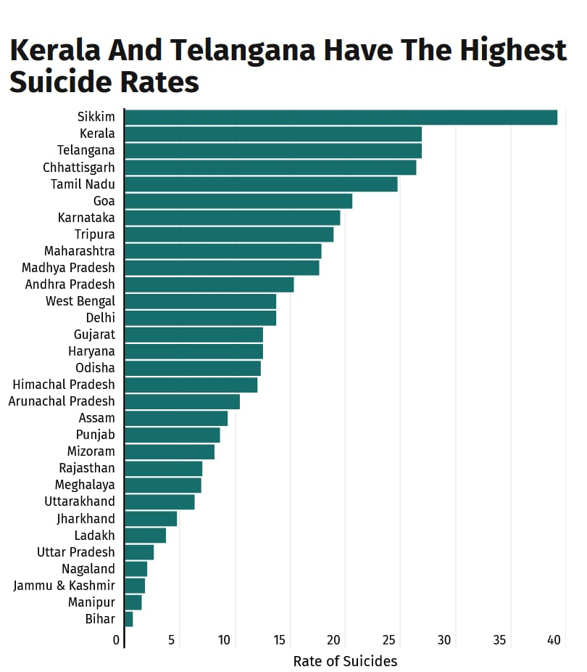
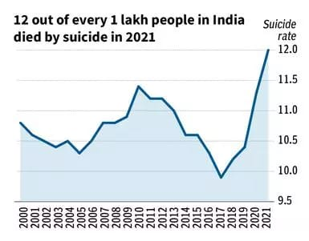
GRAPH:

Slide 6
METHODOLOGY:
FLOW CHART:
START
User visits websites
Chat interface
display
User interacts
Sent back to JavaScript
Response
generated
Sentiment analysis performed
Java script handles input
Response displayed
Continue or exit
User exits conversation
End

Slide 7


TECHNOLOGY STACK:

Slide 8
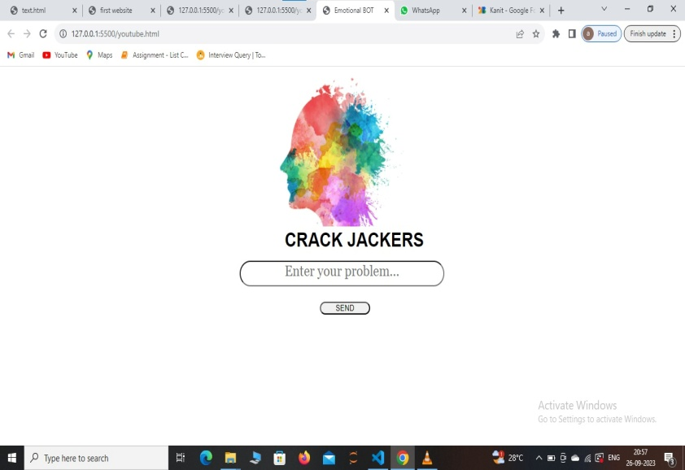
CRACK JACKER:

Slide 9
RESULTS AND DISCUSSIONS:
User Engagement:
Metrics might show high levels of engagement, with users interacting with the chatbot daily or several times a week. This indicates the chatbot's utility and acceptance.
Feedback and Satisfaction:
User feedback through surveys and direct comments could reveal satisfaction with the chatbot's responses, usability, and the mental health strategies it provides.
Crisis Intervention:
Instances where the chatbot successfully identified users in crisis and provided immediate resources or guidance could highlight its potential in emergency situations

Slide 10
Improvement in Mental Fitness Metrics:
Pre- and post-interaction assessments may show improvements in users' reported levels of stress, anxiety, or mood stability, suggesting the chatbot's effectiveness.
Adoption and Engagement:
High engagement levels suggest that users are comfortable with digital platforms for mental health support. This comfort with technology, especially among younger demographics, underscores the importance of designing digital mental health interventions that are accessible and engaging.
Effectiveness of Support:
Positive changes in users' mental fitness metrics can indicate that digital interventions, like chatbots, can play a significant role in mental health self-management. It also suggests that incorporating evidence-based practices into chatbot algorithms is beneficial.

Slide 11
User Satisfaction:
User satisfaction points to the importance of the chatbot's design, including its personality, usability, and the relevance of its content. This underlines the need for continuous user feedback loops in the design and refinement process to ensure the chatbot meets user needs effectively.
Future Directions:
The discussion might explore the potential for integrating the chatbot with other digital health tools or services, enhancing personalization through machine learning, and expanding the chatbot’s capabilities to support a wider range of mental health issues.
Concluding Thoughts:
Overall, the results and discussion should highlight the chatbot's role in supporting mental fitness and stability, the challenges faced, and the potential future directions for digital mental health interventions. This exploration contributes to the broader conversation on technology's place in mental health care, emphasizing the need for careful, user-centered design and continuous evaluation.

Slide 12
REFERENCES:
1.Darcy, A., & Pemberthy, J. T. (2021). Digital Mental Health: Innovations in Technology and Services. Springer. This book provides a comprehensive overview of the current state of digital mental health services, including the use of chatbots.
2.Vaidyam, A. N., Wisniewski, H., Halamka , J. D., Kashavan , M. S., & Torous , J. B. (2023). "Chatbots and Conversational Agents in Mental Health: A Review of the Psychiatric Landscape." Canadian Journal of Psychiatry, 68(2), 126-134. This article reviews the use of chatbots and AI in mental health, providing insights into their effectiveness and challenges.
3.World Health Organization. (2023). "Digital Health and Mental Health." Retrieved from [website URL]. WHO’s insights into the integration of digital tools in mental health care practices globally.
4."A conversational agent for the improvement of mental well-being: A pilot study" by Provoost , S., Lau, H. M., Ruwaard , J., & Riper, H. Journal: BMC Psychiatry Year: 2017Abstract: This paper presents a pilot study on a conversational agent designed for improving mental well-being. The study assesses user engagement, satisfaction, and preliminary effectiveness.

Slide 13
THANK YOU
QUESTIONS ?

